Slide 1

Happy women’s day

Slide 2

pathrise project

Slide 3

Introduction
Pathrise company:
Founded in 2017
An innovative company in online mentorship, career accelerator, and job placement
Provides personalized one-on-one mentorship, insider knowledge, training, and advice
Main Goal of Analysis:
Predict Placement Success: Analyze data to predict if fellows will be placed in companies.
Determine Placement Timeline: Estimate the time required for fellows to achieve placement .
(On average, for fellows who stay with us after their free trial period, it takes about 4 months to receive a final job offer)

Slide 4
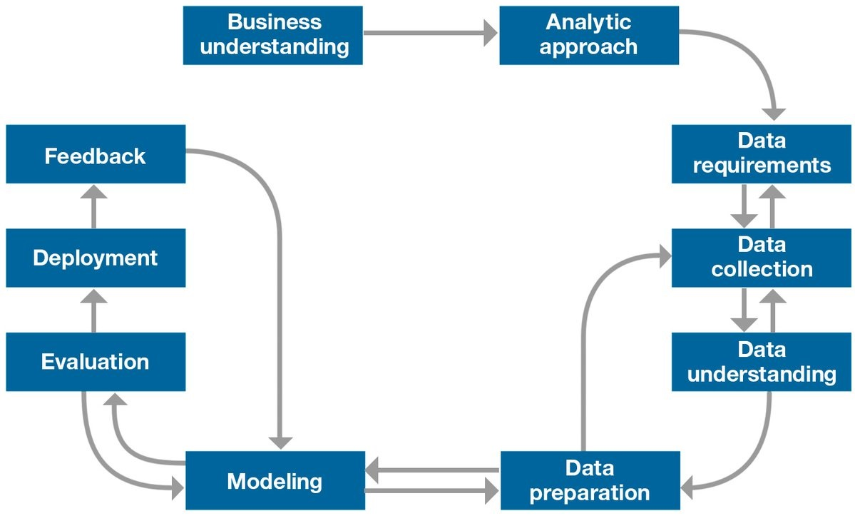
Data project steps:
mythology:
Business understanding
Analytic Approach
(Descriptive, Diagnostic, Predictive, Prescriptive)
Data Understanding
Data Preparation
Modeling
Evaluation
Feedback

Slide 5
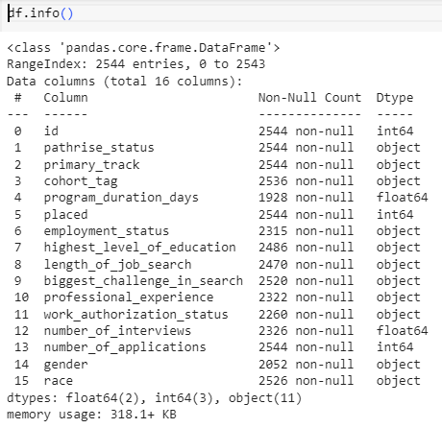
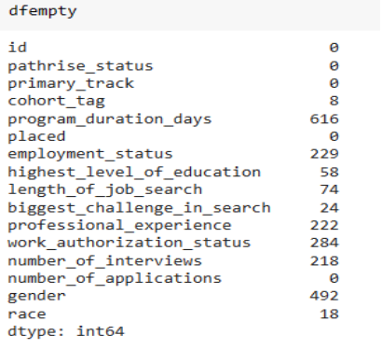
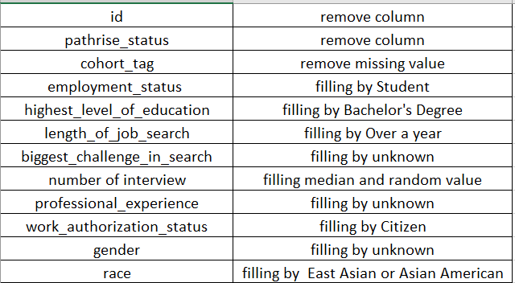
Exploratory data analysis
Data set
Missing value
Ways for cleaning

Slide 6
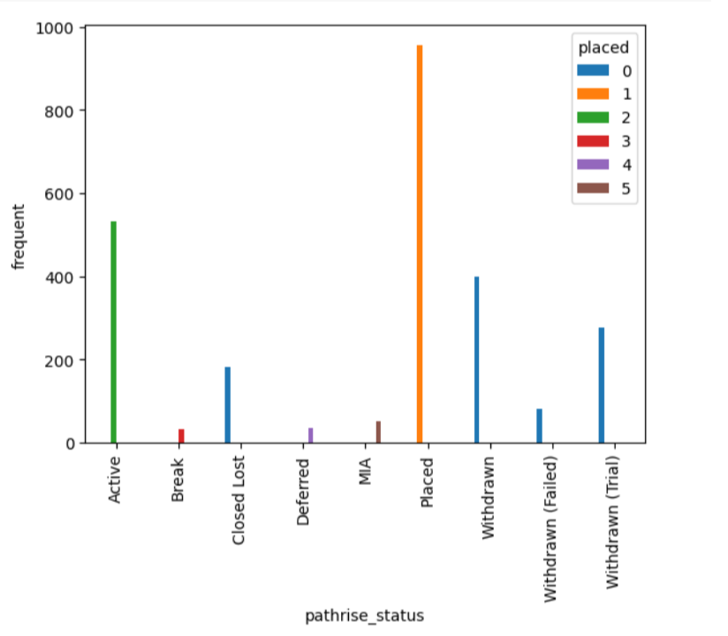
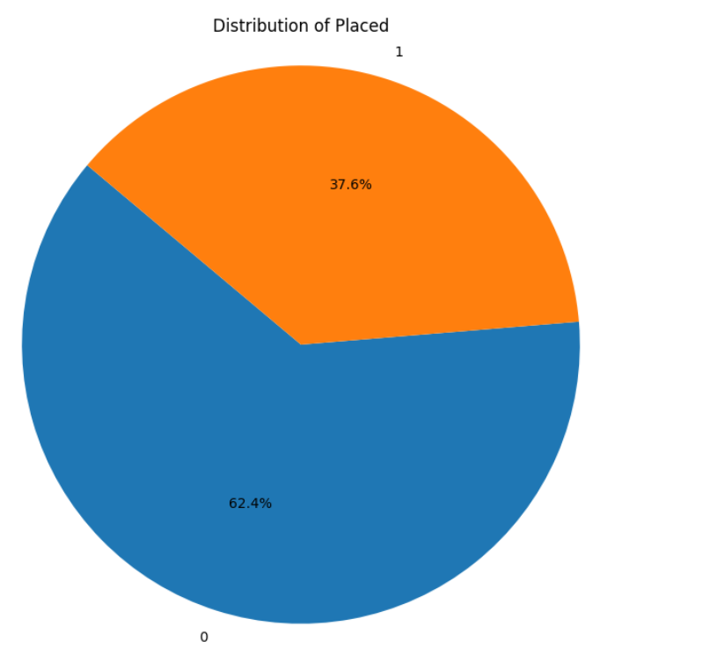
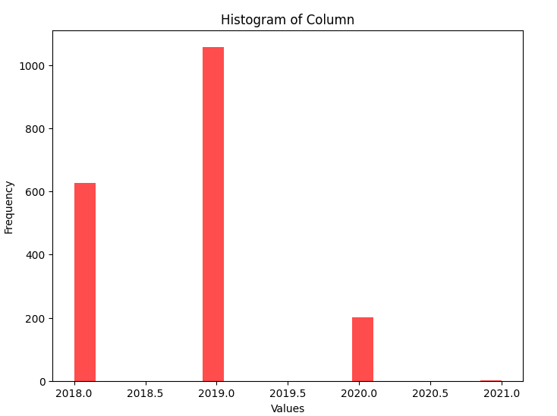
Exploratory data analysis
Unbalanced data

Slide 7
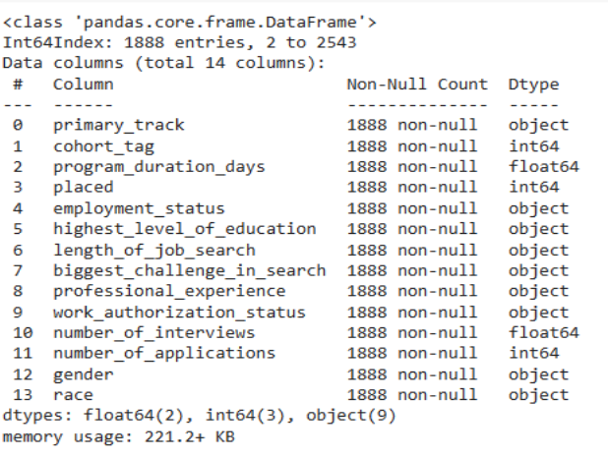
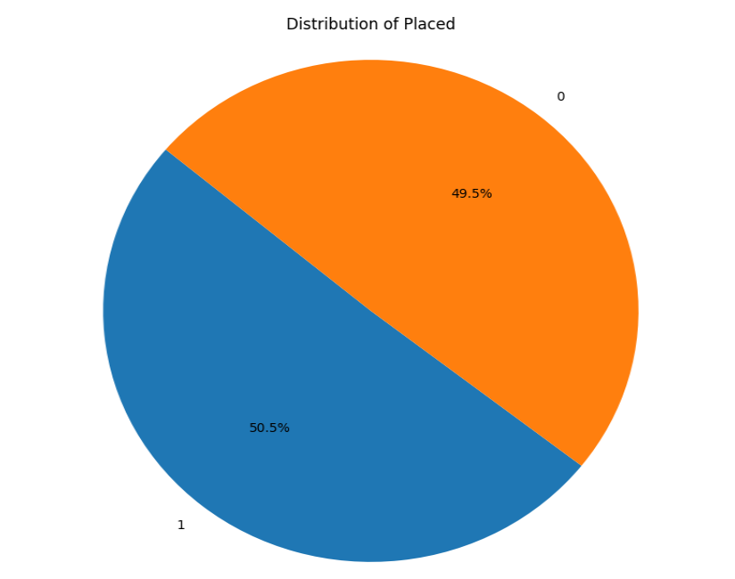
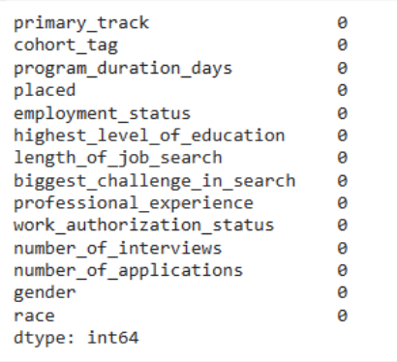
Data preparation: Balanced data

Slide 8
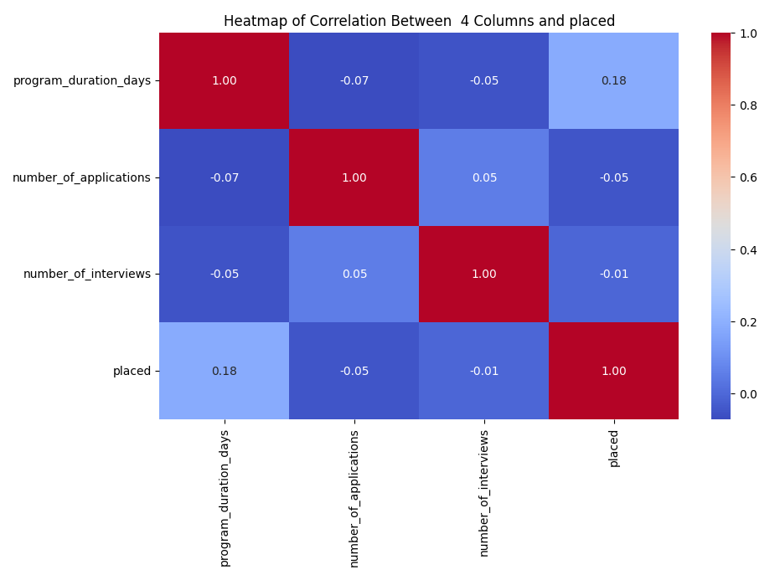
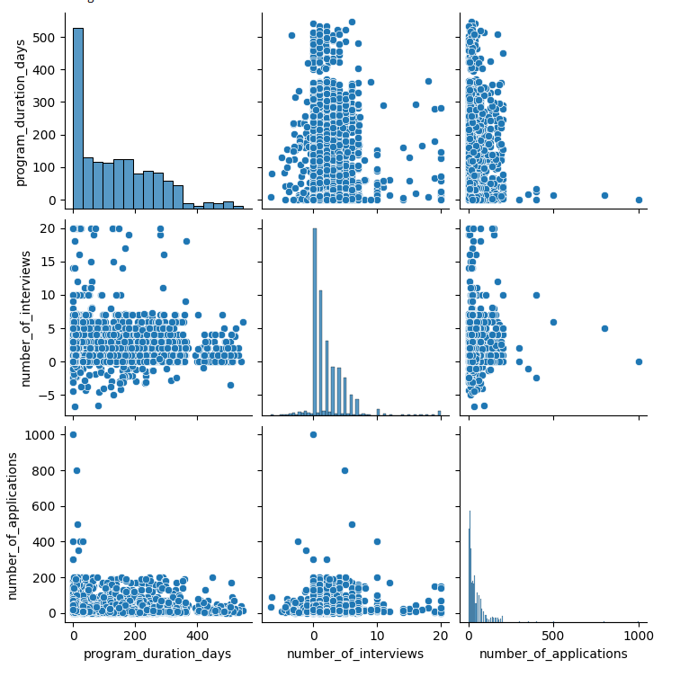
EDA: CORRELATION NUMERICAL COLUMNS

Slide 9
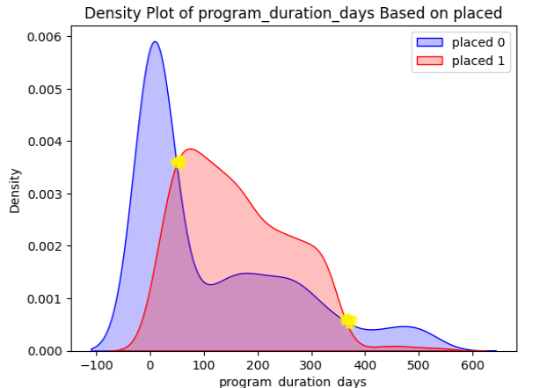
EDA: Program duration days
GOLDEN TIME

Slide 10
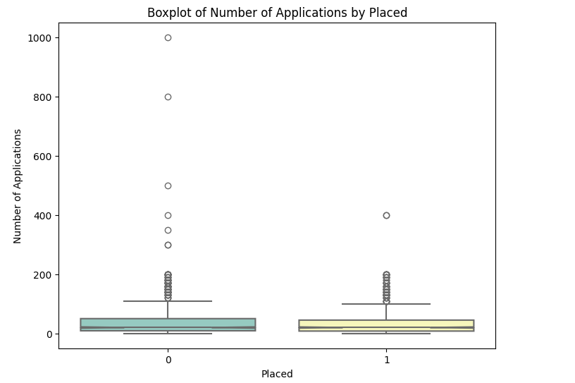
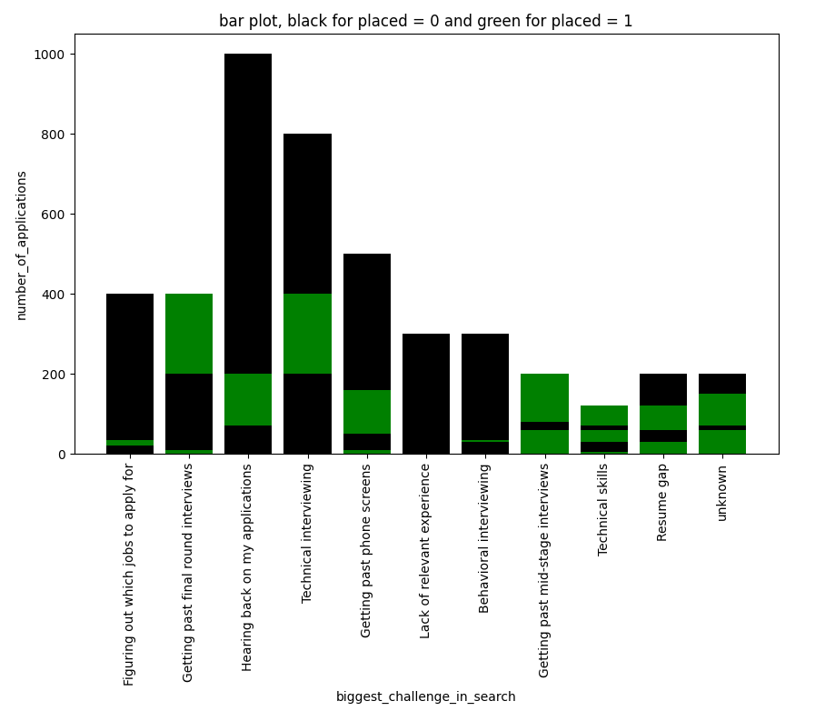
EDA: Number of applications, biggest challenges in search, placed

Slide 11
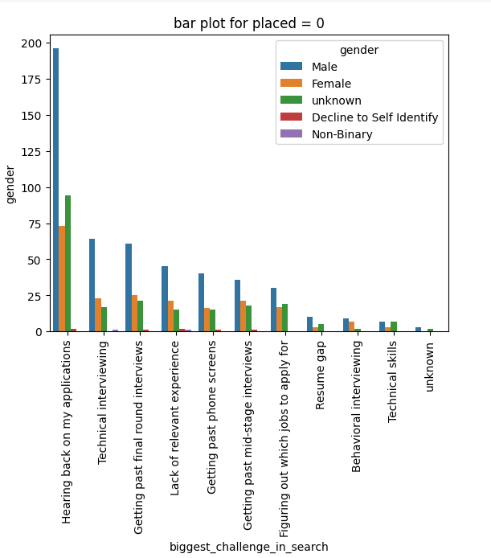
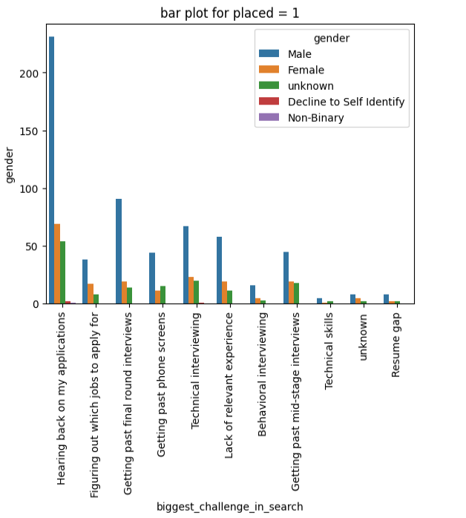
EDA: Gender, biggest challenges in search, placed

Slide 12
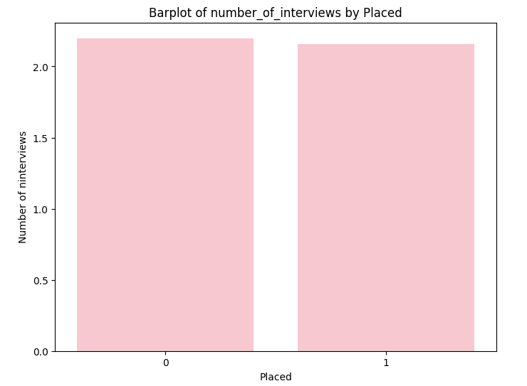
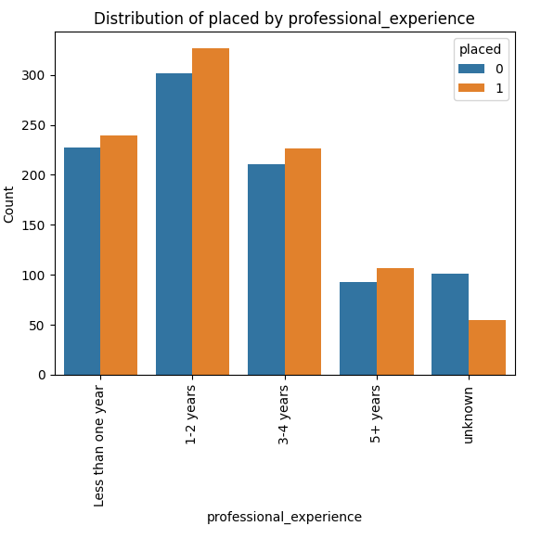
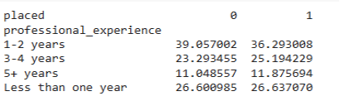
EDA: Number of interviews, Professional experience

Slide 13
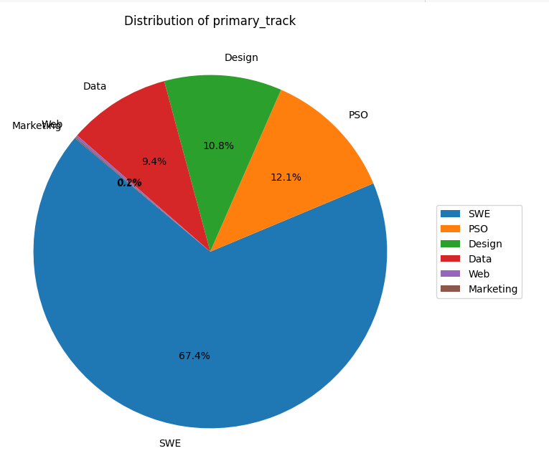
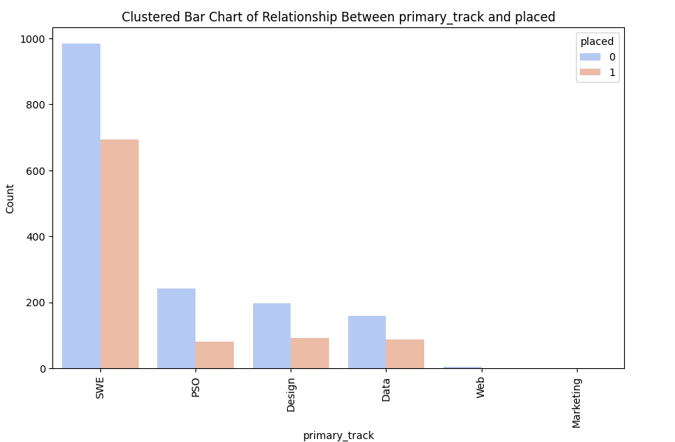
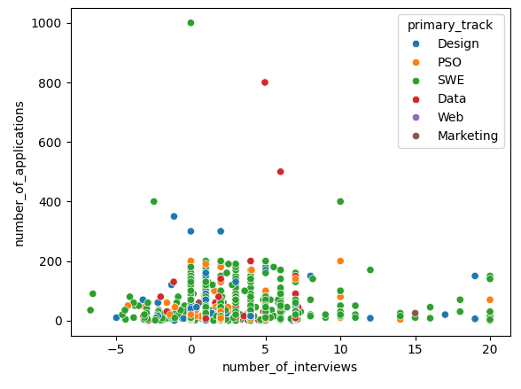
EDA: Primary track

Slide 14
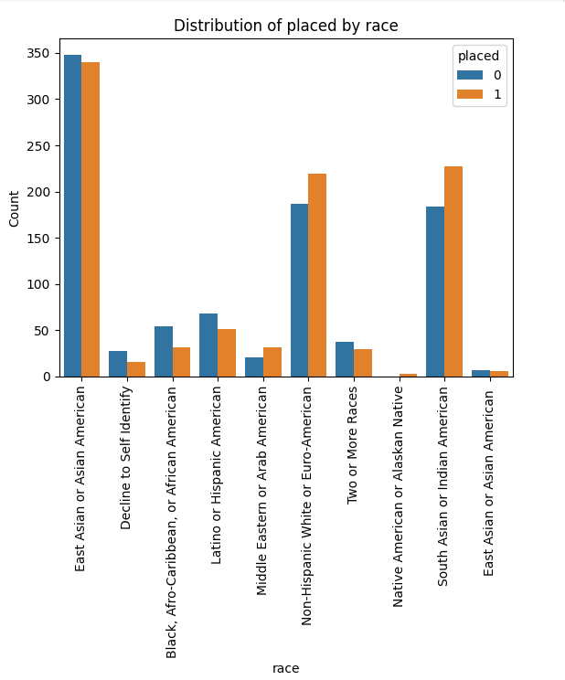
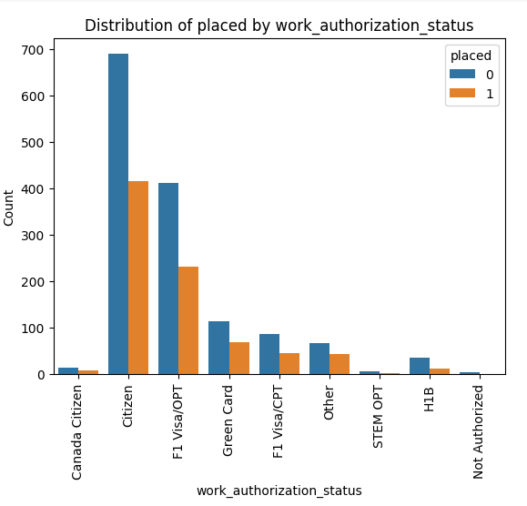
EDA: Race, Work authorization status

Slide 15
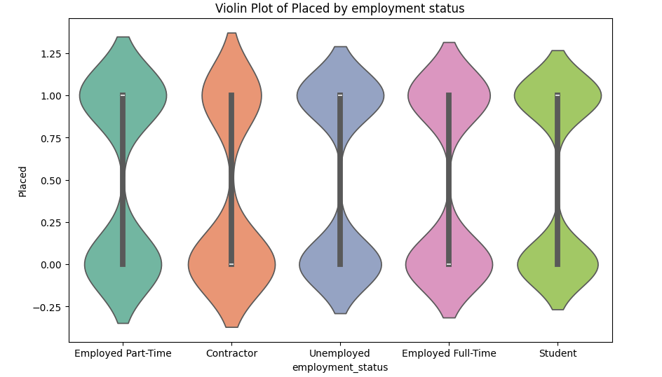
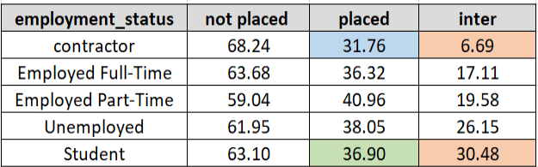
EDA: Employment status

Slide 16
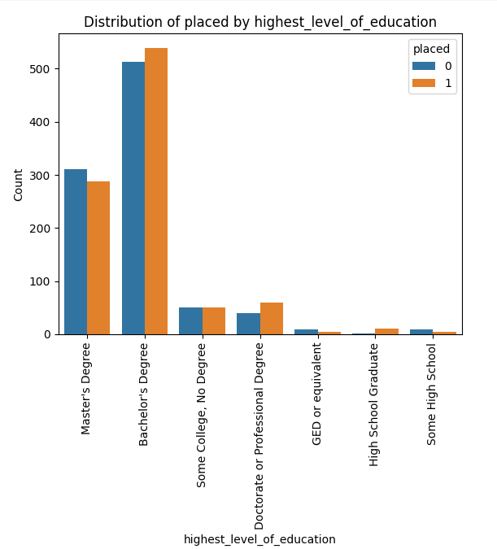
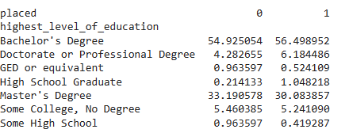
EDA: Highest level of education

Slide 17
Modeling: Categorical (first question)
In our categorical analysis, we carefully selected a suite of advanced modeling techniques to explore and predict outcomes based on our dataset. These models include:
Logistic Regression
SVC
Decision Tree
KNN
Random Forest
QDA
LDA

Slide 18
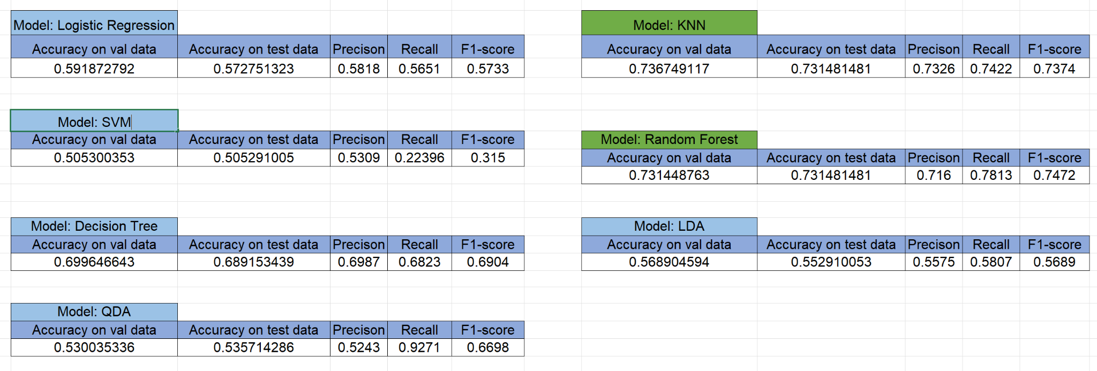
Model Comparison

Slide 19
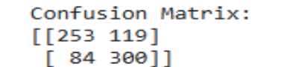
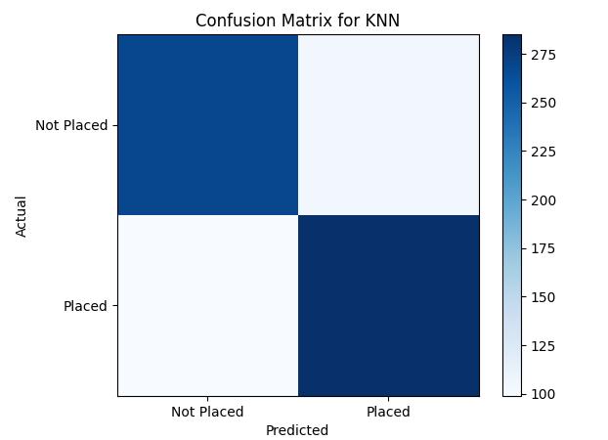
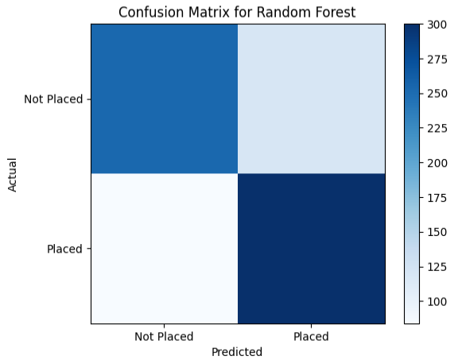
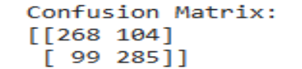
Model visualisation

Slide 20
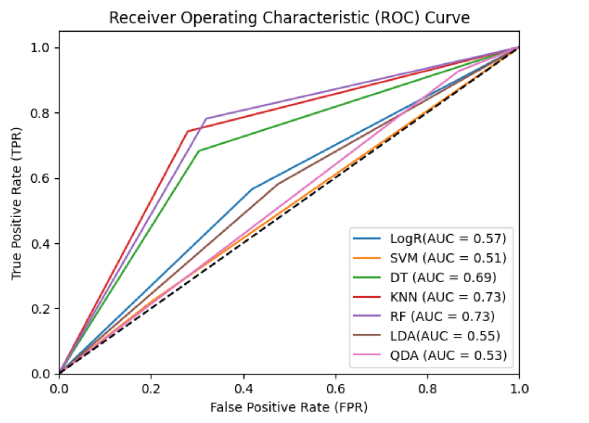
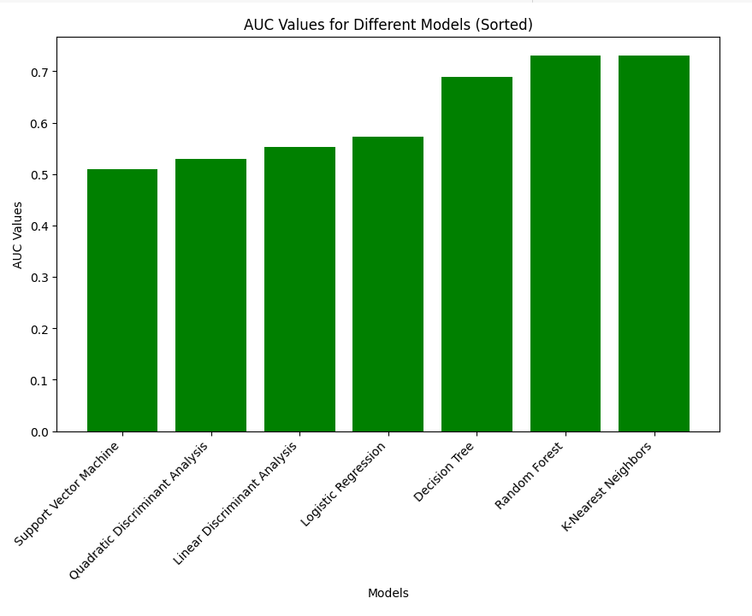
Model visualisation

Slide 21
Modeling: Regression ( second question)
linear regression
Decision Tree
Gradient boosting
Random Forest

Slide 22
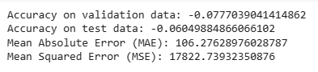
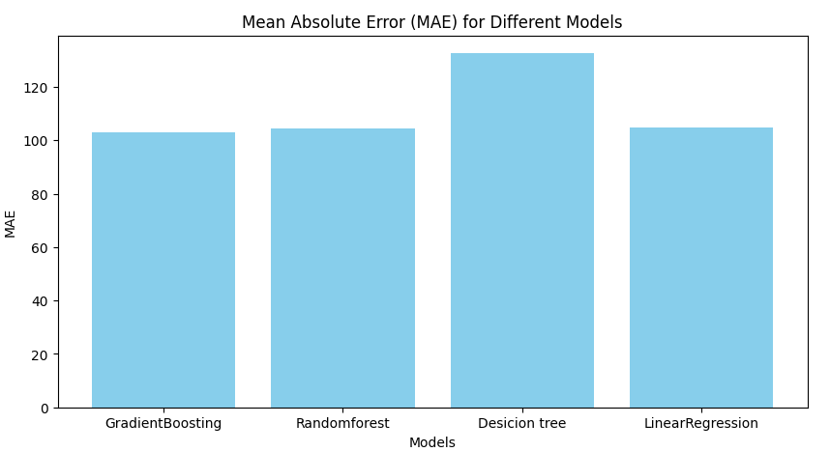
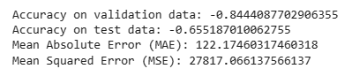
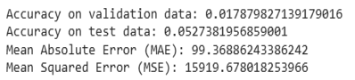
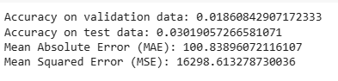
Model Comparison
suitable model was not found among the available models
linear regression
Decision Tree
Random forest
gradient boosting

Slide 23
Recommendations:
Use a user friendly website, changing the form questions on the website, Examining the dynamics of form questions and making answering some questions mandatory (e.g., gender), Collecting information on software skills and useful skills for work
Finding remote jobs for the unemployed
Suggestions to job seekers to increase the skills required for a job
Reviewing fellower’s applications
Examining the interview or conducting a mock interview and expressing the strengths and weaknesses
Contracting with an educational institution to register users and offer certain discount conditions as an option if they attend classes
Examining users' challenges and their reasons provides useful insights for practical solutions to the company
Future project:
Considering the project dataset before and after Corona to find better models
Delete datasets with training time less than 14 days
Testing some other Models
Standardizing and balancing columns
Deleting all outliers, extra columns
Use of the tuning models

Slide 24
Thank you for your attention

